Slide 1
Recurrent Neural Network based Text Generation
Koen Vannisselroij and Sonali Fotedar

Slide 2
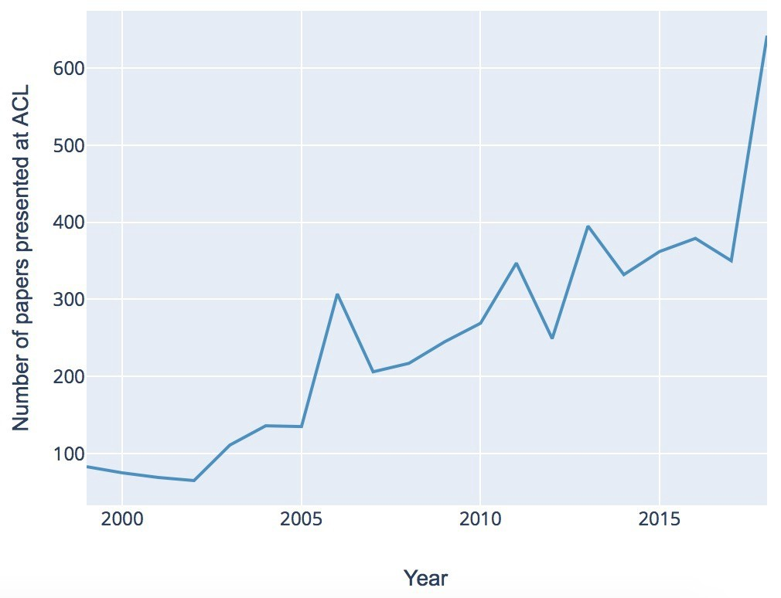
Generating Text
Gaining popularity
Text Summarization
Writing Annual Reports
Twitterbots
Conversational Marketing
Annual Meeting of the Association for Computational Linguistics (ACL)

Slide 3

Understanding Sequential Data
Any data that is a sequence of data points of which the previous data points are relevant for future datapoint prediction (text, weather, stock price charts, audio)
Computer readable format = numbers

Slide 4
Recurrent Neural Networks
Michael Nguyen
First input: the input is a word which gets fed in. Then an output value is calculated based on this word.
For the second word, the information of the previous word is also given as an input. The previous output is recurrent. Then based on both these inputs, an output is given. Which in turn serves as an input to the next state.
Notes:
The block takes as input X for timestamp t, where in our case, X is a piece of text and the timestamp is a word in the text. Then the block does some calculation based on its weights and outputs ht which is the word it thinks is the next in the sequence based on what its weights are. Then this word is compared to the ground truth and the weights are adapted so that in following sequences it is more accurate in the same situation.
What you see in the picture is a rolled up version of the RNN block. Unrolled it looks like this: As you can see here the network is the same but both of the inputs are different every time as the next word in the sequence is the new input and the previous output ht-1 is also new input. Then based on the prior information the new word is generated again.

Slide 5
Recurrent Neural Networks
Michael Nguyen
If we unroll the recurrent block it would look like this. Where the red dots are the input and the black dots the output.
The output is fed to a function called softmax, which assigns a probability to every word that is present in our vocabulary (the datafile used to train the network).

Slide 6

Categorical cross-entropy
The vector of probabilities resulting from this function is evaluated by a so-called loss function, in our case we use categorical cross-entropy to evaluate how well the output was. It checks the ground-truth value and compares this to the softmax output.
Using backpropagation the weights of the network are optimized.
Notes:
Our model uses some regularization techniques which we will not discuss intensively, what they do is make sure that we do not overfit the model. Dropout does this by eliminating some neurons every batch so the network relies on other neurons as well. Our structure is quite simple, we start off with an embedding layer, followed by an LSTM layer, then a dropout layer, another LSTM layer + dropout layer, and in the end a dense layer connected to a final softmax with our vocabulary.
softmax assigns probabilites to each word, then the softmax output and the ground-truth are put in the Categorical cross-entropy loss function that tries to minimize the negative sum of the product of ground-truth vector and the log of the softmax output, we do this for each prediction of a batch and then calculate the average loss to display and optimize.

Slide 7
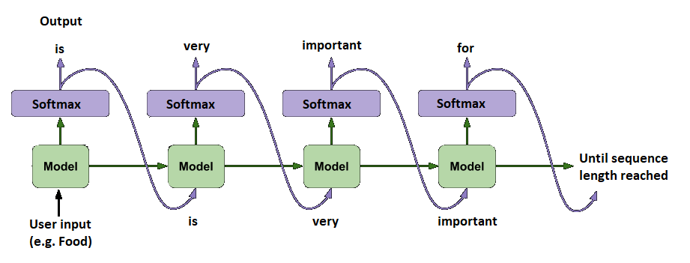
Generating Sequences of Text
Notes:
To generate a sequence of text all we need to do is take the predictions of our model based on an input sequence, save them, put them in a list and then add all of the predictions together and print it or save it in a file. We can do this conditional or unconditional, where conditional generation takes a user input and based on this input begins to generate output. Unconditional generation does not use an input but generates based on random initialization of the input.

Slide 8

GENERATES
Notes:
We will use a dataset containing X amount of works of X to generate new content, we got these datasets from X.

Slide 9
WORKSHOP

Slide 10
Problems with RNN
Andreas Madsen
Long-term dependencies
Notes:
To understand what an LSTM or long short term memory block does, we need to understand why an RNN does not capture long-term dependencies. An RNN looks at only a part of the input text and what it generated, words earlier in the sequence get less weight the further it generates text. In theory it should be possible to remember the long-term dependency but in practice the network focuses on short-term dependencies and does not learn long-term dependencies.

Slide 11
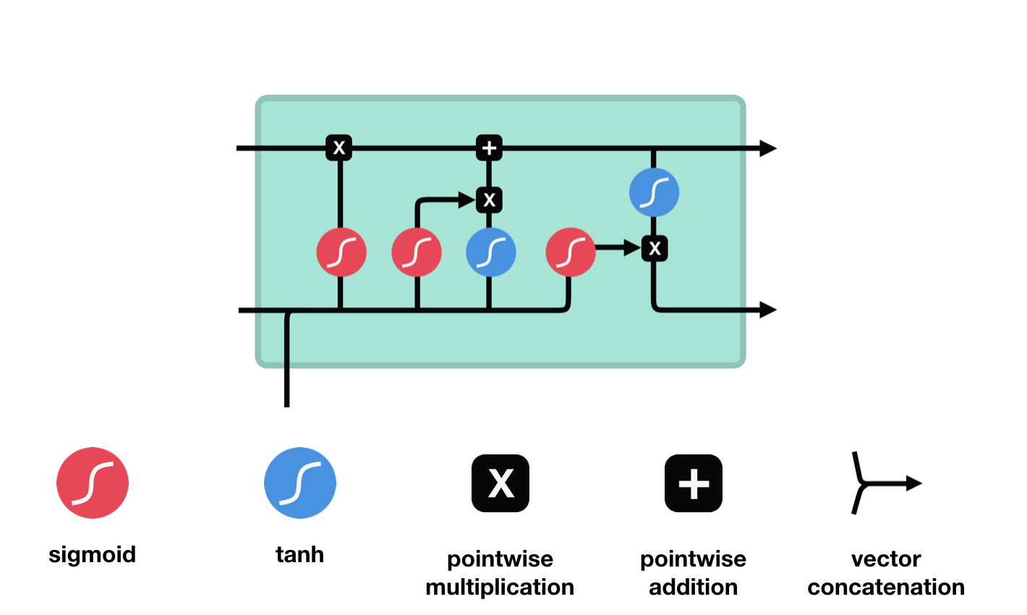
Michael Nguyen
Output
Previous Cell state
Output of previous cell
Notes:
Therefore, it is necessary to alter the RNN block in such a way that it is able to remember words that were in the sequence before and that have relevance for future output.
This is exactly what LSTM does. LSTM has multiple so called ‘gates’ and a memory cell called Ct corresponding to its current state during t. The gates make sure that the cell state remembers and forgets the correct information.

Slide 12
Michael Nguyen
The forget gate determines if the information that the LSTM-block remembered for the last input is still relevant for the new input. It takes the previous output in account when determining what information is worth keeping.

Slide 13
Michael Nguyen
The update gate determines which part of the new information should be added to the cell state. After selecting which values to update it creates values for the input that is worth remembering.

Slide 14
Michael Nguyen
The pipeline for the cell state runs the previous cell state through the values calculated by the forget gate, removing information that is not worth to remember, and then adds the information that is worth remembering for the next input. After this the cell state is given to the next cell as input.

Slide 15
Michael Nguyen
The output gate uses the input of the previous block to determine what needs to be given as an output, taking into account what the cell state has remembered when creating an output. Then the output goes to the next layer of the network, and serves as input to the next state of the next LSTM cell.

Slide 16
Further Reading
Understanding LSTM Networks
General Text Generation
Attention
Transformer Models

